Slide 1
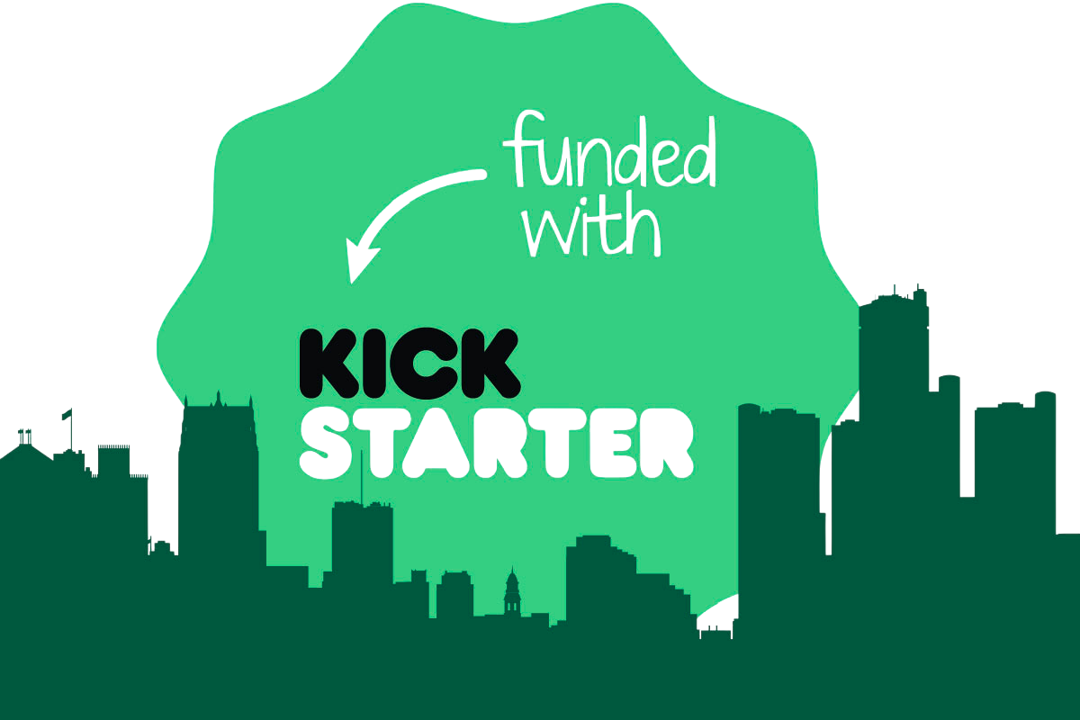
DECODING KICKSTARTER: DATA-DRIVEN STRATEGIES FOR CAMPAIGN SUCCESS
DONE BY : Eman Aljowair & Raghad Rashed & Zainab Qambr

Slide 2

CONTENT
01
Introduction
IDEA
02
Key Insights & Findings
03
Actionable Insights and Recommendation

Slide 3
INTRODUCTION
Analyzing key factors like category, goal amount, and duration to understand what drives funding.
Identifying patterns in successful campaigns to help creators make informed decisions.

Slide 4


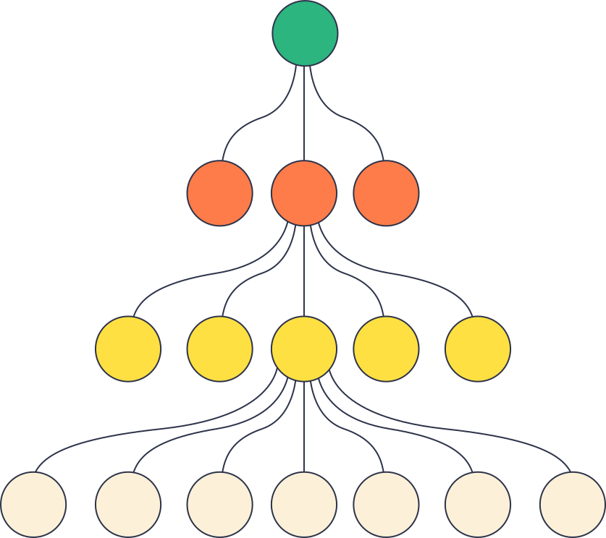
No One can predict the future.
But a machine can!
Our team have developed a machine algorithim model that can predict the amount of the project pledge
helping creators optimize their strategy before launch.

Slide 5


Key Features
13
categories
45.7K
Projects
54.72%
45.28%
Kickstarter supports
including music, technology,
food, and design and so on.
had launched us
data included .
SUCESSFUL PROJECTS
FAILED PROJECTS

Slide 6
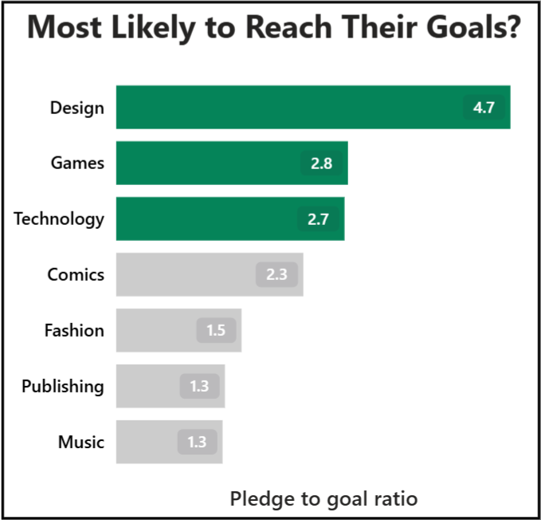
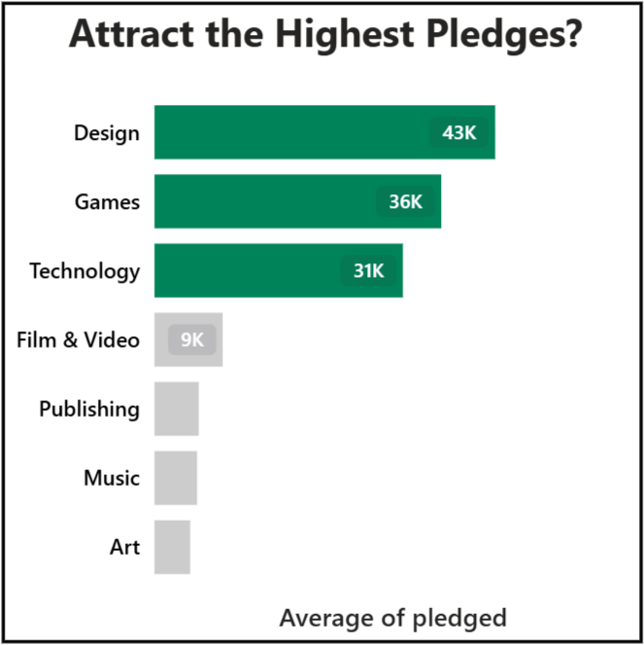
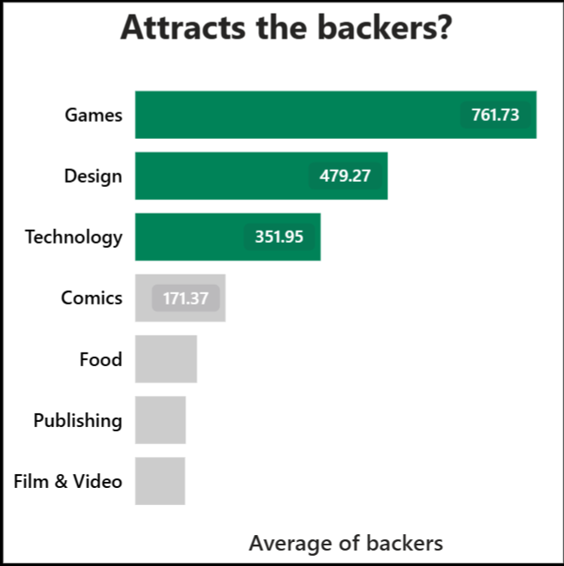
Successful project: financial values:

Slide 7
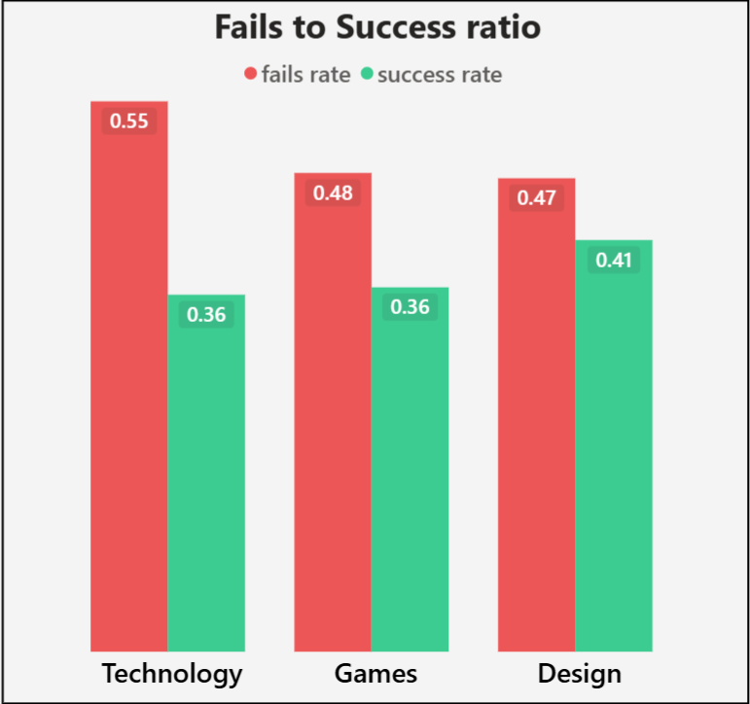
One problem: Fail or Sucess?

Slide 8
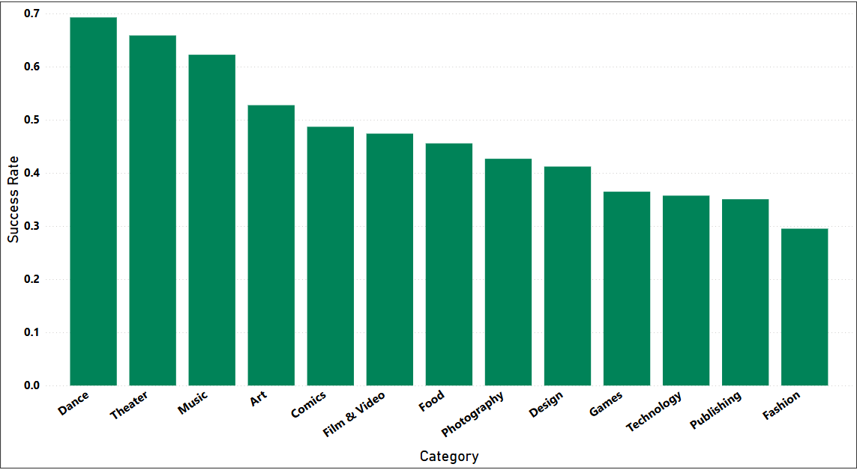
Kickstarter Success Rates by Category

Slide 9
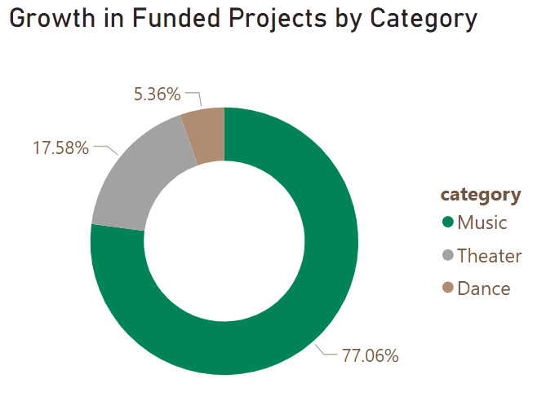
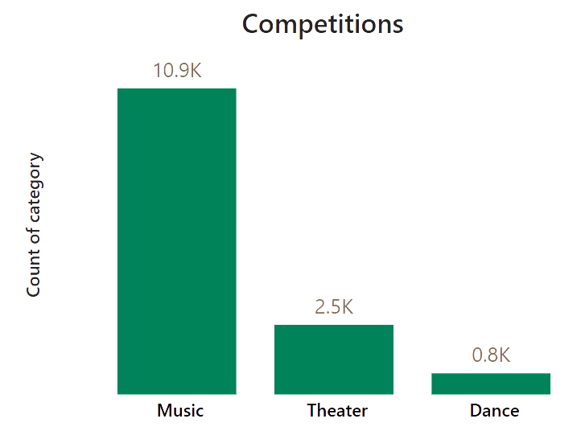
MOST SUCCESFUL RATE PROJRCTS
The average project duration of around 30-40 days across Music, Theater, and Dance.
The average goal for the categories is:
Music = 7.4K
Theater = 5.5K
Dance = 4.9K

Slide 10
THANK YOU

